Slide 1
Graph Representation Learning
1
I- DNA (Intelligent Data, Network, and AI) Lab.
배홍섭(Bae Hong Seob)
I- DNA (Intelligent Data, Network, and AI) Lab.

Slide 2
Message Passing
2
I- DNA (Intelligent Data, Network, and AI) Lab.
배홍섭(Bae Hong Seob)
I- DNA (Intelligent Data, Network, and AI) Lab.

Slide 3
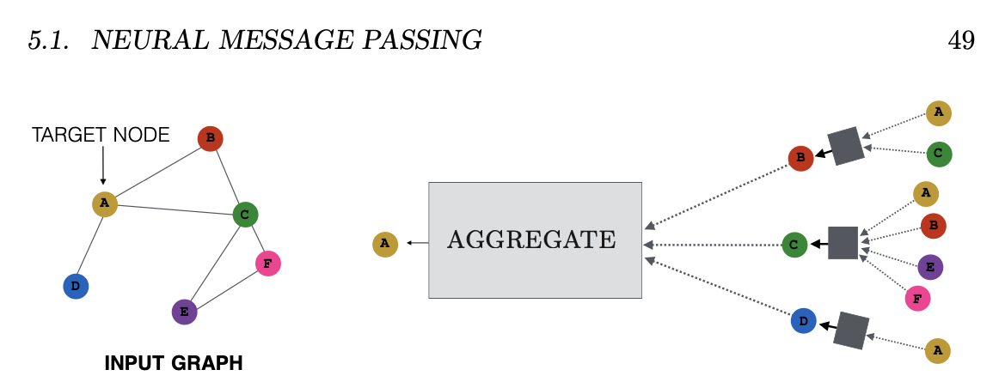

Message Passing
The defining feature of a GNN is that it uses a form of $neural message passing$in which vector messages are exchanged between nodes and updated using neural networks [Gilmer et al., 2017].
I- DNA (Intelligent Data, Network, and AI) Lab.
배홍섭(Bae Hong Seob)
Notes:
https://thejb.ai/gcn/

Slide 4
Message Passing
Message = information(e.g., node features)
Message Passing : aggregate message.
오른쪽 그림은 2layer 예시. Target A의 이웃은 B,C,D
B는 또 A,C로부터 C는 A,B,E,F 로부터, D는 A로부터 aggregate message.
I- DNA (Intelligent Data, Network, and AI) Lab.
배홍섭(Bae Hong Seob)
Notes:
https://thejb.ai/gcn/

Slide 5
Negative sampling
5
I- DNA (Intelligent Data, Network, and AI) Lab.
배홍섭(Bae Hong Seob)
I- DNA (Intelligent Data, Network, and AI) Lab.

Slide 6
Negative sampling
Why?
계산의 효율성
How?
Parameter update시 중요한 것만 뽑아서 update.(모든 파라미터를 업데이트할 필요 없음)
In gnn: target노드의 이웃 노드 parameter만 update.
한 100 홉의 이웃 노드 parameter를 업데이트 할 필요는 없다.
I- DNA (Intelligent Data, Network, and AI) Lab.
배홍섭(Bae Hong Seob)
Notes:
https://thejb.ai/gcn/

Slide 7
SOTA model for recommend system
7
I- DNA (Intelligent Data, Network, and AI) Lab.
배홍섭(Bae Hong Seob)
I- DNA (Intelligent Data, Network, and AI) Lab.

Slide 8
SOTA model
Graph4Rec: A Universal Toolkit with Graph Neural Networks for Recommender Systems(2019)
Dataset: RetailRocket3 , Rec154 , Tmall5 and UB6 . RetailRocket
Improving Training Stability for Multitask Ranking Models in Recommender Systems(2023)
Dataset: Conducted on a YouTube production dataset
Mixed Dimension Embeddings with Application to Memory-Efficient Recommendation Systems
Dataset: MovieLens dataset, Criteo Kaggle dataset(2019)
Compositional Embeddings Using Complementary Partitions for Memory-Efficient Recommendation Systems(2019)
Dataset: Criteo Ad Kaggle Competition dataset
I- DNA (Intelligent Data, Network, and AI) Lab.
배홍섭(Bae Hong Seob)
Notes:
https://thejb.ai/gcn/

